Slide 1
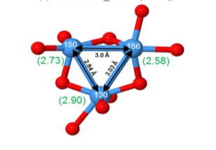
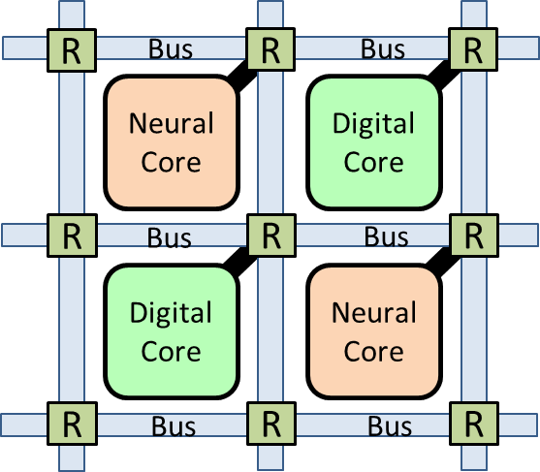
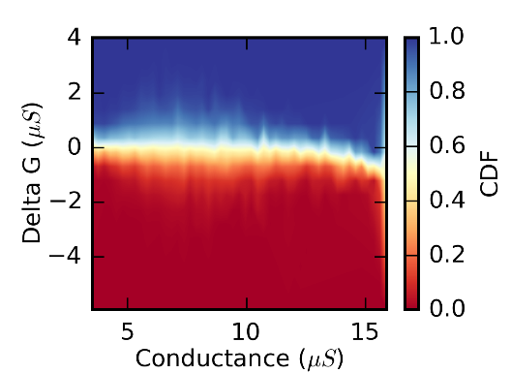
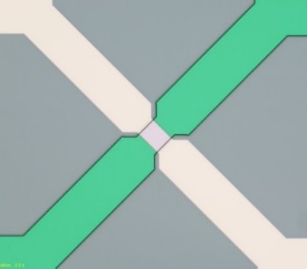
Neuromorphic Algorithm Acceleration with
Resistive Memory NanoCrossbars
M.J. Marinella*, S. Agarwal, E. Fuller, A.A. Talin, F. El Gabaly, R. Jacobs-Gedrim,
D.R. Hughart, R. Goeke, A. Hsia, R. Schiek, S.J. Plimpton, and C.D. James
Sandia National Laboratories
*matthew.marinella@sandia.gov
1

Slide 2
Outline
Intro and Key Concepts
Device Requirements for a Crossbar Accelerator
Modeling ReRAM in a Crossbar Accelerator
CoDesign Framework Concept
Conclusion
Notes:
IRDS Emerging Research Devices and Architectures NanoCrossbar Workshop
Date/time: 9-5, Friday July 15, 2016 at Rambus in Santa Clara, CA
Moffet Towers, 1050 Enterprise Way #700, Sunnyvale CA 94089
Organizer: Paul D. Franzon, paulf@ncsu.edu, 919 656 4411 (M)
In the 2015 chapter, we identified that nanocrossbar arrays were coming close to being a deployable computing technology for neuromorphic, analog computing, and of memories. We wish to expand upon this section in the 2017 chapter. To that purpose, we are holding a work shop whose goes are as follows:
1. Identify and quantify the state of the art in devices, design, modeling, fabrication, and employment of Nano-enabled Crossbars for computing.
2. Identify the research barriers impeding the use of NanoCrossbars for computing.
Examples of questions that it would be helpful for you to consider addressing in your talk include the following.
General, including memories
- What is the status of achieving linear repeatable response, low power, sufficiently long retention, fast writes, sufficiently distinguishable resistances in different states, and long write endurance in one nanoscale device?
- Is the access device issue solved? What are the remaining issues?
Neuromorphic computing
- What are the requirements on device linearity, scalability and dynamic range?
o What is achieved today?
o What are the tradeoffs exposed in achieving this?
- What style of non-traditional computing is best suited to nanodevice arrays? E.g. spiking neuron, deep network, full logic map, etc.
o Why?
o What are the specific gaps in device properties that are preventing us from achieving this paradigm?
Analog computing
- What are the requirements on device linearity, scalability and dynamic range?
o What is achieved today?
o What are the tradeoffs exposed in achieving this?
- What is the required device yield? What mechanisms are available for implementing working arrays in the presence of <100% yield?
- What levels of noise during readout can be tolerated?
- To what degree could closed-loop control (e.g., iterative resistance-tuning for higher accuracy) be available during device write?
Agenda:
Each presentation will consist of approximately 20 minutes of presentation and 20 minutes of discussion. Its OK if you go over 20 minutes. (Schedule subject to change).
0900– 0930 : Introduction: Paul Franzon, NC State University
0930 – 1020 : Matt Marinella, Sandia
1020 – 1040 : Break
1040 : 1120 : Geoff Burr IBM
1120 – 1200 : David Mountain, DOD (via Webex or phone)
1200 – 1300 : Lunch
1300– 1340 : Dmitri Strukov, UCSB
1340– 1520 : Kevin Cao, ASU
1520– 1540 : Break
1540 - 1620: Miao Hu, HPE
1620 – 1700 : Wei Lu, UMich
1700 – 1710 : Paul Franzon, Wrapup
--
Paul D. Franzon,
Distinguished Professor of Electrical and Computer Engineering
Director of Graduate Programs (EB2 3014B, 919 513 0501)
paulf@ncsu.edu; O: 919 515 7351; M: 919 656 4411
http://www.ece.ncsu.edu/erl/faculty/paulf.html
Box 7911, ECE, NCSU, Raleigh 27695
MRC 443, 2410 Campus Shore Dr., Raleigh NC 27606

Slide 3
Why do we need more efficient computers?
Google Deep Learning Study
  16000 core, 1000 machine GPU cluster
  Trained on 10 million 200x200 pixel images
  Training required 3 days
  Training set size set by what can be
  completed in less than one week
What would they like to do?
  ~2 billion photos uploaded to internet per day (2014)
  Can we train a deep net on one day of image data?
  Assume 1000x1000 nominal image size, linear scaling (both assumptions are unrealistically optimistic)
  Requires 5 ZettaIPS to train in 3 days
  (ZettaIPS=10²¹ IPS; ~5 billion modern GPU cores)
  Data is increasing exponentially with time
Need >10¹⁶-10¹⁸ instruction-per-second on 1 IC
  Less than 10 fJ per instruction energy budget
Q. Le, IEEE ICASSP 2013
Notes:
We are not targeting deep learning specific hardware
Note that hardware improvements are largely responsible for the recent era of neuromorphic computing
Better computing hardware enables progress (in many areas)
Neural algorithms for the first time

Slide 4

Where Are we Today?
Single Unit: Nvidea Tesla P100 GPU
  Most advanced GPU processor specs (announced, not yet released)
  Target’s deep learning and neural applications
  20 TFLOP/s 16 bit peak performance w/ peak power dissipation of 300W
  70 GFLOP/watt or about 15 pJ/FLOP (16 bit)
Supercomputer: Sunway TaihuLight (China)
  Top supercomputer in the world
  ShenWei processor
  90 PFLOP/s peak, 15 MW power
  6 GFLOP/W or about 170 pJ/FLOP
Need >1000x improvement

Slide 5
Evolution of Computing Machinery
10⁵ pJ/MAC
1980’s
Improvements Due Soley to Transistors (Moore’s Law and Denard Voltage Scaling)
Early DSP Demonstrations
1990’s
10⁴ pJ/MAC
2000’s
10³ pJ/MAC
2010-Present
Modern GPU, 32 bit precision
10² pJ/MAC
Single GPU Card, Late 2016
10 pJ/MAC
Exascale System Goal
2025?
1 pJ/MAC
1 TMAC/W
100 fJ/MAC
Analog VMM Prototypes
10 fJ/MAC
“Let physics do the computation” Our brain is the ultimate example of this paradigm
2035?
1 fJ/MAC
Neuromorphic Target
(Efficiency only possible with neural hardware & algorithms)
100 aJ/MAC
10 aJ/MAC
Modified from Hasler and Marr, Frontiers in Neuroscience, 2013
1 aJ/MAC
Biological Neurons*
*Caveat: Biological neurons probably do not perform MACs
5
Notes:
So, is computing done?
Energy is a useful metric – has been scaling since ENIAC

Slide 6
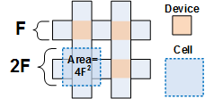
Resistive RAM (ReRAM)
ERD: Bipolar Metal Oxide Redox RAM
Resistance is modulated in a metal oxide
Scalable to 5nm, sub pJ switching energies
TiN/Ta/TaOx/TiN used as example material (SNL version)
CrossSim modeling applies to all resistive switching crossbars
  We will demonstrate simulation of other novel devices also
Read Window
Highest current switching process
Notes:
Going to show architecture we’re pursuing and example of multiscale model.
Still quite far off from Universal Modeling Framework
Integrated Circuit to accelerate neural algorithms which operate on weight matrices, and perform
Utilizes an emerging memory device configured as a crossbar to achieve energy dissipation in the <20 fJ
We are constructing a device
Algorithm-level results have been used to guide device and materials research
Integrated Circuit to accelerate neural algorithms which operate on weight matrices, and perform
Utilizes an emerging memory device configured as a crossbar to achieve energy dissipation in the <20 fJ
We are constructing a device
Algorithm-level results have been used to guide device and materials research

Slide 7
Crossbar Theoretical Limits
Potential for 100 Tbit of ReRAM on chip
If each can perform 1M computations of interest per second (1 M-op):
  10¹² active devices/chip x 10⁶ cycle per second →10¹⁸ comps per second per chip
  Exascale-computations per sec on one chip!
In order to not melt the chip, entire area must be limited to ~100W
Allowed energy per operation = P x t/op = 100W / 10¹⁸ = 10⁻¹⁶ = 100 aJ/operation
10nm line capacitance = 10 aF
Can charge line to 1V with 10 aJ
Drawback: “only” ~100B transistors/chip
Notes:
Basically if you can reduce computation to charging a line, this would enable exascale chips

Slide 8
How does a crossbar perform a useful computation per device?
Electronic Vector Matrix Multiply
Mathematical
Electrical
V
W
V^{T}W=I
V₁
V₂
V₃
W_{1,1}
W_{1,2}
W_{1,3}
V₁
G_{1,1}
G_{1,2}
G_{1,3}
W_{2,1}
W_{2,2}
W_{2,3}
=
V₂
G_{2,1}
G_{2,2}
G_{2,3}
W_{3,1}
W_{3,2}
W_{3,3}
V₃
G_{3,1}
G_{3,2}
G_{3,3}
I₁=ΣV_{i,1}W_{i,1}
I₂=ΣV_{i,2}W_{i,2}
I₃=ΣV_{i,3}W_{i,3}
I
I₁=ΣV_{i,1}G_{i,1}
I₂=ΣV_{i,2}G_{i,2}
I₃=ΣV_{i,3}G_{i,3}

Slide 9
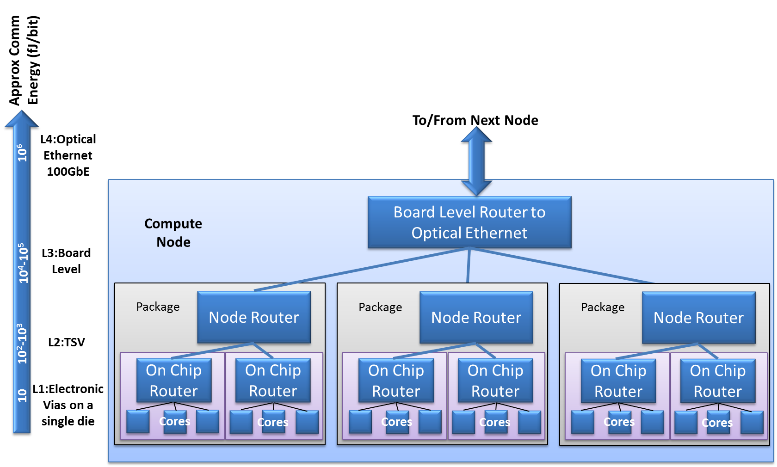
Why is it essential to cram so many computations on a single chip?
Can you simply connect millions of ultra-efficient chips?
Yes, but every time data leaves the chip, it is elevated in the comm hierarchy
→Energy efficiency per operation is reduced
Crossbar accelerator cores
Notes:
I.e. why can’t you string together millions of ultra efficient processors.
You can if very few operations are needed – then you may be ok to ignore this i.e. - TrueNorth
Otherwise you need a comm heirary
If you are SWAP constrained the need to cram ops on a single chip obvious
Supercomputers are typically 1000 to 10000x performance of single chip

Slide 10
Outline
Intro and Key Concepts
Device Requirements for a Crossbar Accelerator
Modeling ReRAM in a Crossbar Accelerator
CoDesign Framework Concept
Conclusion

Slide 11
Mapping Backprop to a Crossbar
Output
Neuron
Backpropagated error from following layer
w…
w₁
w₂
ctrl 1
ctrl 2
Inputs
Error Sum
Backpropagated error to previous layer
Inputs from previous layer
Error Sum
out
Error Sum
in
ctrl 1
Neuron
Neuron
Neuron
Vector Matrix Multiply, Rank 1 Update:
Key kernel used in many algorithms
Outputs to next layer

Slide 12


Experimental Device Nonidealities
Read Noise
Ideally weight would increase and decrease linearly
Experimental devices have several
Device: Write Variability, Write Nonlinearity, Asymmetry, Read Noise
Circuit: A/D, D/A noise, parasitics
I₀+∆I
I $∝$G$∝$W
I₀
I₀-∆I
Time (V_{read}=100mV)
Conductance versus Pulse
= Ideal
= Write Variability
= Nonlinear
Symmetric and Linear
G$∝$W
Asymmetric, Nonlinear
Pulse Number (V_{write}=1V, t_{pulse}=1µs)

Slide 13
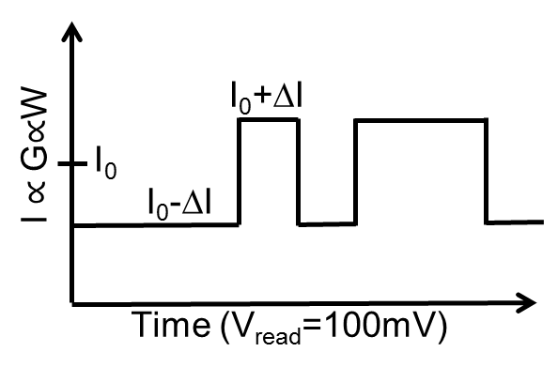
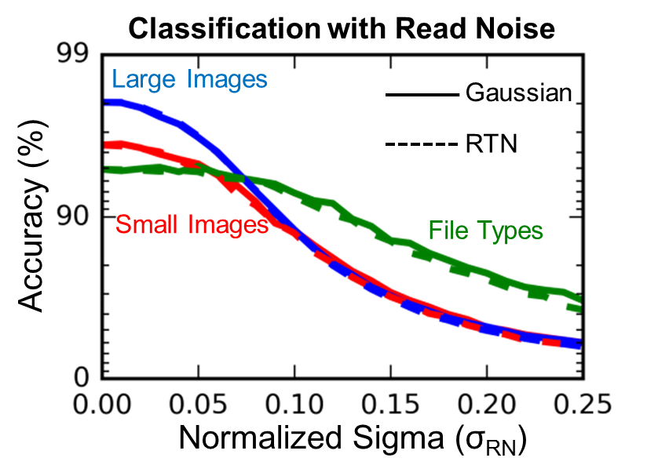
CrossSim Training and Classification with Read Noise
Classification w/ read noise: minimal accuracy degradation until σ_{RN}≈0.05
Training w/ read noise: minimal accuracy degradation until σ_{RN}≈0.05
Data set | # Training Examples | # Test Examples | Network Size
UCI Small Digits[1] | 3,823 | 1,797 | 64×36×10
File Types[2] | 4,501 | 900 | 256×512×9
MNIST Large Digits[3] | 60,000 | 10,000 | 784×300×10
  No read noise present

Slide 14
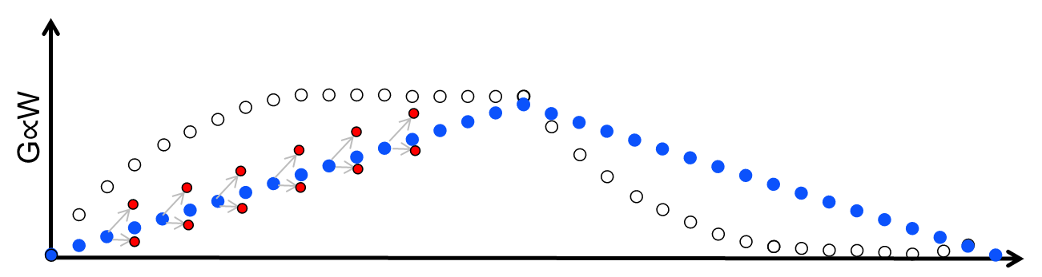
CrossSim Training with Write Noise
Classification with write noise: Much more sensitive to noise
Depends on dataset and initial weigh choice
Data set | # Training Examples | # Test Examples | Network Size
UCI Small Digits[1] | 3,823 | 1,797 | 64×36×10
File Types[2] | 4,501 | 900 | 256×512×9
MNIST Large Digits[3] | 60,000 | 10,000 | 784×300×10
σ_{WN}=0
σ_{WN}=0
σ_{WN}=0

Slide 15
Device Requirements
Conclusions:
  Read noise within typical device capabilities,
  Write noise requirement very difficult to meet
  Low current requirement provides additional challenge
Next: Measure and assess experimental resistive switches against these requirements
 | Small Images | Large Images | File Types
Read Noise σ (% Range) | 3% | 5% | 9%
Write Noise σ (% Range) | 0.3% | 0.4% | 0.4%
Asymmetric Nonlinearity (ν) | 0.1 | 0.1 | 0.1
Symmetric Nonlinearity (ν) | >20 | 5 | 5
Maximum Current | 160 nA | 13 nA | 40 nA
Minimum Retention (@ 85ºC) | 7 days | 7 days | 7 days
Minimum Nudge Endurance | 10⁷ | 10⁷ | 10⁷
15

Slide 16
Outline
Intro and Key Concepts
Device Requirements for a Crossbar Accelerator
Modeling ReRAM in a Crossbar Accelerator
CoDesign Framework Concept
Conclusion

Slide 17
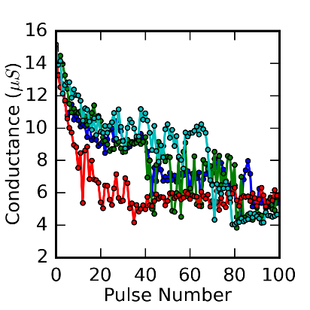
TaOx ReRAM Model
Modeling effect of bipolar TiN/Ta/TaOx/TiN ReRAM
Pulse through all states repeatedly
Arrange data as required by CrossSim model
Create look-up table and analytical noise model for higher-level numerical simulation
G versus Pulse Number
(V=-1V, pulse width = 50ns)
Delta G vs G
(Decreasing Conductance)
CDF

Slide 18
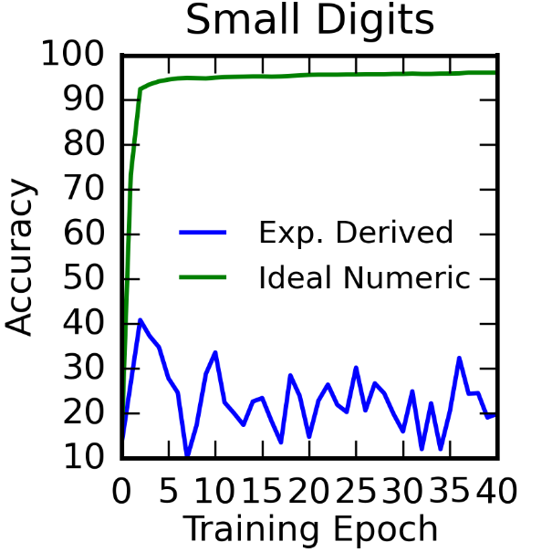
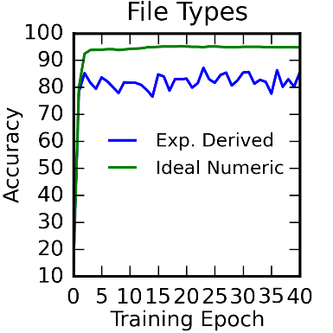
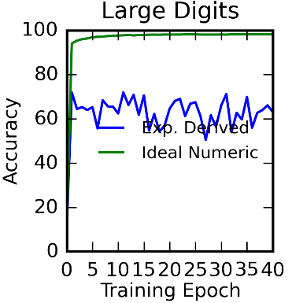
TaOx ReRAM in Backprop Traning
Increasing Network Size
Strong dependence on data set and network size
Data set | # Training Examples | # Test Examples | Network Size
UCI Small Digits[1] | 3,823 | 1,797 | 64×36×10
File Types[2] | 4,501 | 900 | 256×512×9
MNIST Large Digits[3] | 60,000 | 10,000 | 784×300×10

Slide 19
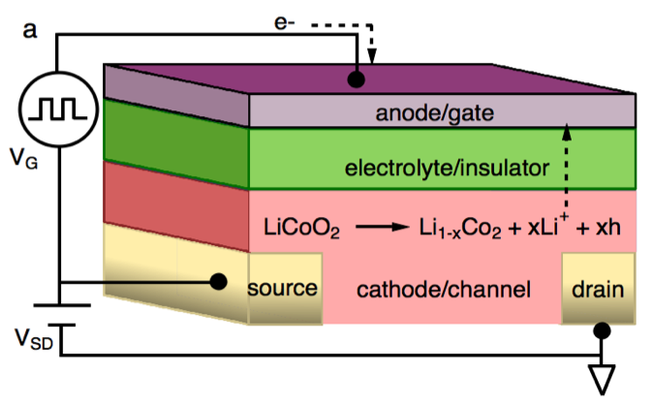
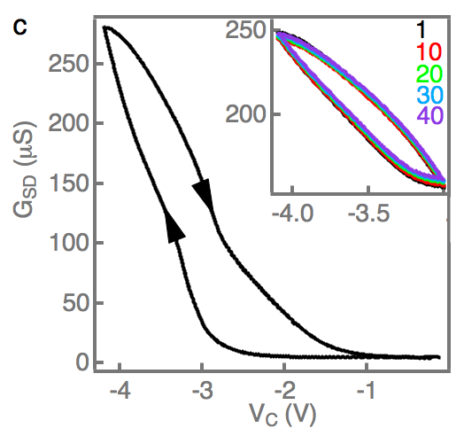
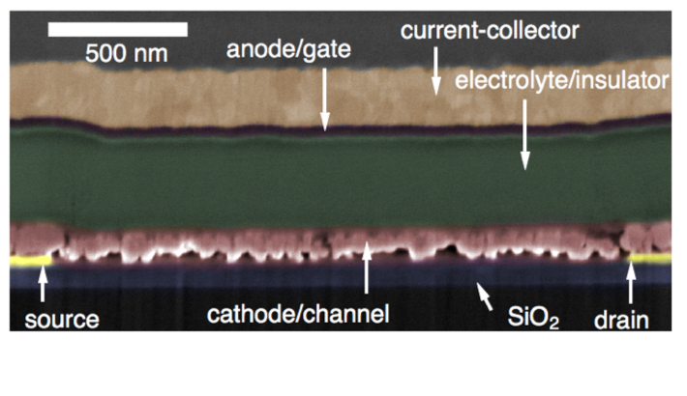
Li-Ion Synaptic Transistor for Analog Computation (LISTA)
G-V for LISTA Transistor

Slide 20
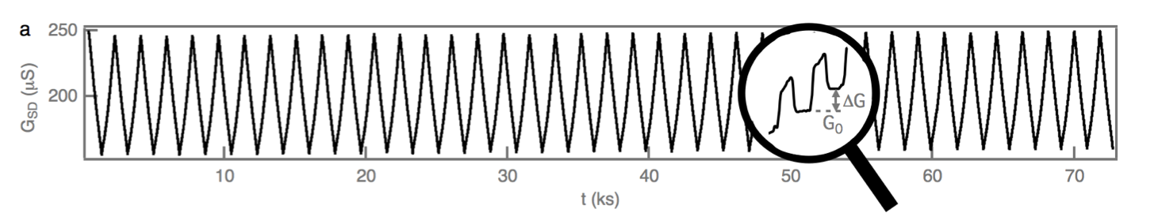
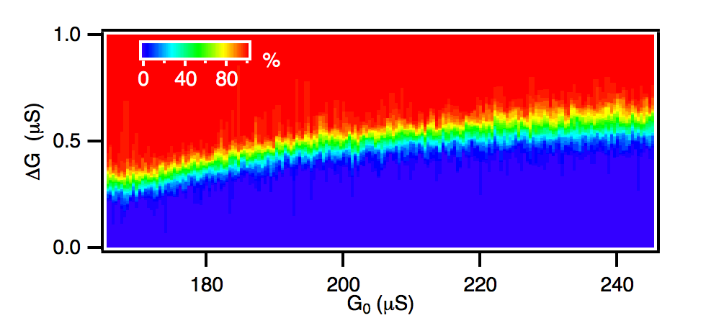
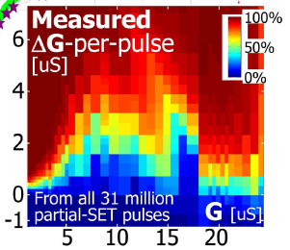
Analog State Characterization
TaOx ReRAM
LISTA > 200 states
PCM Array
GW Burr et al, IEEE TED 2015
Notes:
Note that to be fair PCM is actually over a bunch of devices.

Slide 21
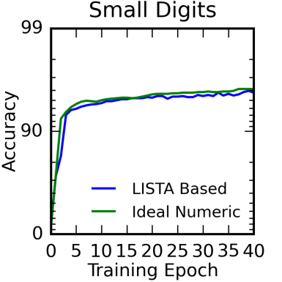
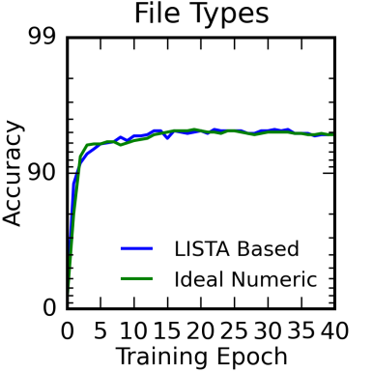
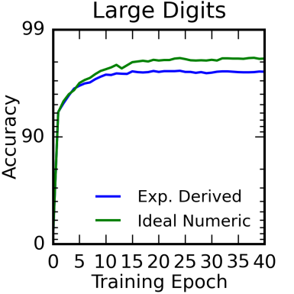
LISTA-device Performance for Backprop Algorithm
Increasing Network Size
Data set | # Training Examples | # Test Examples | Network Size
UCI Small Digits[1] | 3,823 | 1,797 | 64×36×10
File Types[2] | 4,501 | 900 | 256×512×9
MNIST Large Digits[3] | 60,000 | 10,000 | 784×300×10

Slide 22
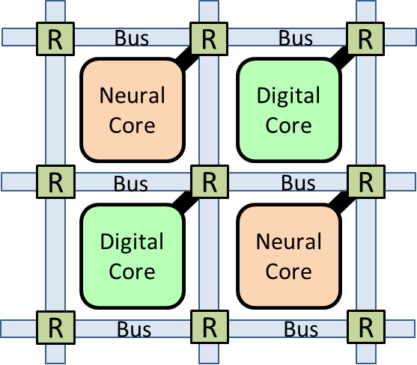
Next Steps
CrossSim/Xyce circuit-level crossbar energy analysis
  Can model fundamental limits and current devices
  Select device model is implement
Explore circuit techniques to improve algorithm performance (w/ less than perfect devices)
Design accelerator microarchitecture
  Routing technique tradeoffs and comm hierarchy
  Local computation capabilities
  Local cache sizes (SRAM bits per crossbar bit)
Model system energy and performance

Slide 23
Outline
Intro and Key Concepts
Device Requirements for a Crossbar Accelerator
Modeling ReRAM in a Crossbar Accelerator
CoDesign Framework Concept
Conclusion

Slide 24
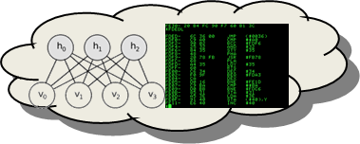

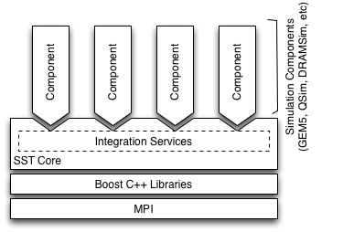
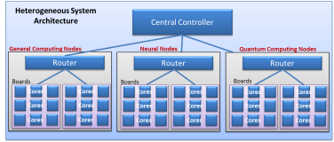
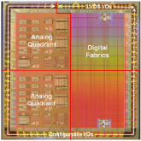

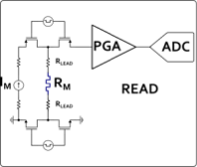
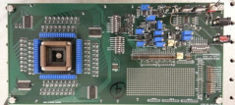
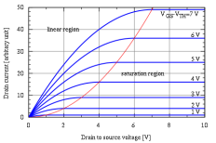
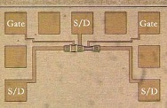
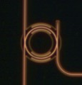
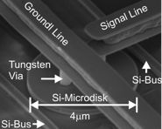
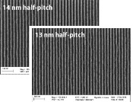
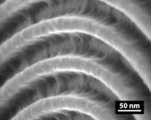
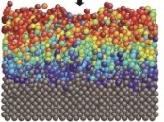

DOE Vision: Universal Multiscale CoDesign Framework
Application Performance Modeling
10,000x improvement:
10 fJ per instruction equivalent
Modeling
Computer System Architecture Modeling
Next generation of Structural Simulation Toolkit
Heterogeneous systems HPC models
Systems
Component Level Models
Gem5, McPAT, HiHAT, CACTI, NVSIM
Component Fabrication
Processors, ASICs
Photonics
Memory
Circuit/IP Block Design and Modeling
SPICE/Xyce model
Test Circuit Fab and Measurement
Subcircuit measurement
Compact Device Models
Single device electrical models
Variability and corner models
Devices
Device Measurements
Single device electrical behavior
Parametric variability
TEM/EELS
Device Physics Modeling
Device physics modeling (TCAD)
Electron transport, ion transport
Magnetic properties
Device Structure Integration and Demonstration
Novel device structure demonstration
Process Module Modeling
Diffusion, etch, implant simulation
EUV and novel lithography models
Materials
Process Module Demonstrations
EUV and novel lithography
Diffusion, etch, implant simulation
Atomistic and Ab-Initio Modeling
DFT – VASP
--SOCORRO
MD – LAMMPS
Fundamental Materials Science
X-ray: XRD, XPS, HAXPES
Microscopy: TEM, SEM, EELS
Scanning probe technique
Experimental
Notes:
The goal of a universal modeling framework is a large task – perhaps a big idea. We are following basic methodology for a neural accelerator
Now we will turn to an example we are building
Explain how this integrated framework leverages the labs strength and MISSION, and engages both modeling and experimental science
There are many indiviual activities happening in each of these areas, but there is nothing that integrates them together.
In the Charter of the National Strategic Computing Initiative, the DOE is identified as a lead agency for computing systems,
with a mission to create integrated efforts that LEAD to fully integrated systems.
It is our job… it is our MISSION to address this first order energy challenge...

Slide 25
Outline
Intro and Key Concepts
Device Requirements for a Crossbar Accelerator
Modeling ReRAM in a Crossbar Accelerator
CoDesign Framework Concept
Conclusion

Slide 26
Conclusion
Recent progress in neural computing such as Deep Learning is a direct result of Moore’s Law and Dennard Scaling
As this slows, a new direction will be needed to achieve the next 3 orders of magnitude in energy efficiency and performance gains
Crosspoint memory, when used as a computation device can enable near exa-feature per second on a single chip
CrossSim model has directed device requirements from algorithmic considerations
  In the process of open sourcing this modeling software
Novel lithiated device LISTA offer significant potential for neural algorithm acceleration

Slide 27

Thank you!

Slide 28
Acknowledgements
This work is funded by Sandia’s Laboratory Directed Research and Development as part of the Hardware Acceleration of Adaptive Neural Algorithms Grand Challenge Project
Many shared ideas among collaborators:
  DOE BIS: John Shalf, Ramamoorthy Ramesh, Patrick Nealeau
  Dave Mountain, Mark McLean, US Government
  Stan Williams, John Paul Strachan, HPL
  Jianhua Yang, U Mass
  Hugh Barnaby, Mike Kozicki, Sheming Yu, ASU
  Sayeef Salahuddin, UC Berkeley
  Engin Ipek, U Rochester
  Tarek Taha, U Dayton
  Paul Franzon, NC State University
  Dhireesha Kudithipudi, RIT
  Alberto Saleo, Stanford
  Dozens of others…
We are especially interested in collaborations on cross-sim!

Slide 29
Backup Slides

Slide 30
Theoretical Efficiency Analysis
SRAM crossbar:
ReRAM crossbar:
V₁=x₁
-
WL[0]
+
w₁₁
w₁₂
w₁₃
w₁₄
V₂=x₂
-
+
N rows
WL[1]
w₂₁
w₂₂
w₂₃
w₂₄
N rows
V₃=x₃
-
+
WL[2]
w₃₁
w₃₂
w₃₃
w₃₄
V₄=x₄
-
+
w₄₁
w₄₂
w₄₃
w₄₄
BL[0]
BL[1]
BL[2]
M columns
M columns
SRAMs must be read one row at a time
→charges M columns;
E = N Rows x O(N) wire length x M Columns
~ O(N²×M)
Energy to charge the crossbar is CV²;
E ∝ C ∝ number of RRAMs ∝ N×M
~ O(N×M)
Implication: Crossbar is O(N) better than SRAM in energy consumption for vector-matrix multiply computations

Slide 31
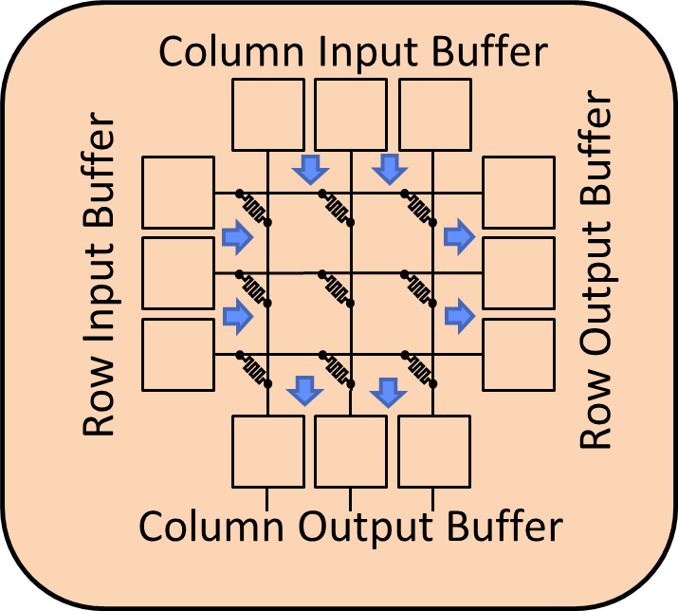
HAANA Crossbar Accelerator Design
Initial work by several groups indicates order of magnitude energy efficiency gains are possible using a ReRAM accelerator
The assumptions and outcomes of these models vary significantly
HAANA goal: develop a Multiscale CoDesign Framework which can evaluate our neural crossbar accelerator algorithms, architectures, and devices on a “level playing field”
Evaluate architectures and devices for accuracy, energy, perf.
Once a clear energy advantage demonstrated, move forward with technology development
R
Bus
R
Bus
R
Neural Core
Digital Core
R
Bus
R
Bus
R
Digital Core
Neural Core
R
Bus
R
Bus
R

Slide 32
HAANA Crossbar Accelerator Model
Algorithm
Cross-Sim Numerical Model
Architecture
Cross-Sim Numerical Model
CACTI/McPAT model of Energy and Performance
Crossbar Circuits
Cross-Sim Numerical Simulator
Cross-Sim Xyce Simulator
Devices
Xyce-Based Compact Model
REOS (SNL), Charon (SNL), and other Continuum Device models
Materials
DFT (VASP) of oxides
Notes:
The rest of this talk going to focus on cross-sim modeling of devices

Slide 33
Analog Core: Forward Propagation
O(N²) Operations
O(N) Operations
k
y_{j}
out
w_{ij}
Digital Core
in
j
Neuron Function
y_{i}
i

Slide 34
Analog Core: Back Propagation
k
y_{i}
Digital Core
w_{ij}
j
i
O(N²) Read Operations
y_{i}
O(N) Operations
O(N²) Write Operations

Slide 35
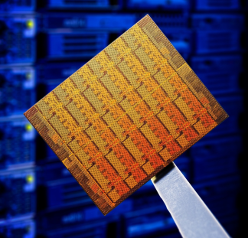
How can we get to fJ computing?
Description | NPU-1 | NPU-2 | NPU-3 | TrueNorth
System clock frequency | 100kHz | 1 MHz | 10 MHz | 1 kHz
Synapses per neuron | 500 | 500 | 500 | 256
Average energy per device update | 1 fJ | 1 fJ | 10 aJ | 26 pJ
Energy per update op cycle (per core) | 250pJ | 250pJ | 2.5pJ
Operations per second (per core) | 250 GOPs | 250 GOPs | 250 GOPs
Single core max power | 25 uW | 250 uW | 25 uW
Chip Area | 4 cm² | 4 cm² | 4 cm² | 4.3 cm²
Cores per layer | 800 k | 800 k | 800 k | 4 k
Layers per chip | 10 | 100 | 10 | 1
Neurons per chip | 4 B | 200 B | 4 B | 1 M
Chip Max Power | 200 W | 10 kW | 200 W | 70 mW
Chip Max operations per second | 0.2 ExaMACS | 10 ExaMACS | 20 ExaMACS | 28 GigaOps
Operations per second per watt | 10¹⁵ MACS/W | 10¹⁵ MACS/W | 10¹⁷ MACS/W | 4x10¹¹Ops/W
MACS = Multiply Accumulate per Second
Notes:
NPU3 – wire capacitance limited

Slide 36
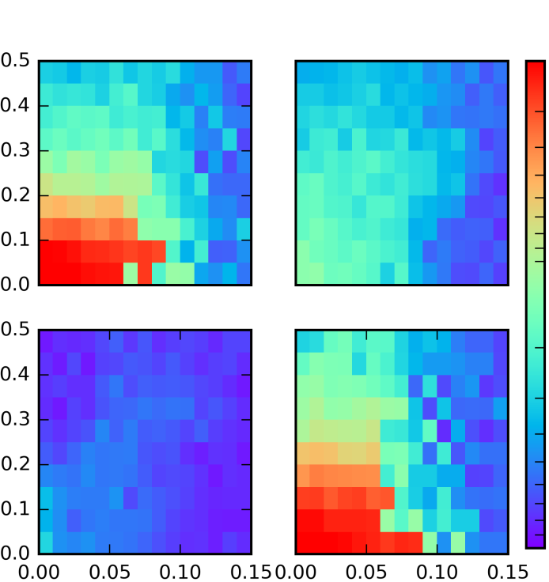
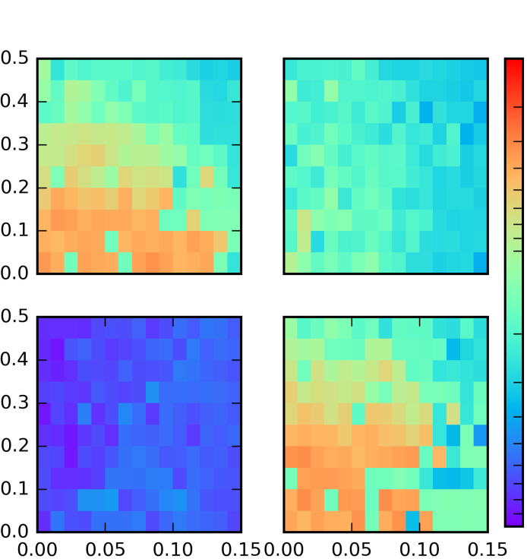
Combined Effects of Nonidealities
MNIST
Accuracy
File Types
Accuracy
Linear
Asymmetric, ν = 1
98
Linear
Asymmetric, ν = 1
98
Write Noise (σ_{WN})
Write Noise (σ_{WN})
90
90
Asymmetric, ν = 5
Symmetric, ν = 5
Asymmetric, ν = 5
Symmetric, ν = 5
Write Noise (σ_{WN})
Write Noise (σ_{WN})
0
0
Read Noise (σ_{RN})
Read Noise (σ_{RN})
Read Noise (σ_{RN})
Read Noise (σ_{RN})

Slide 37
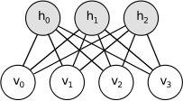
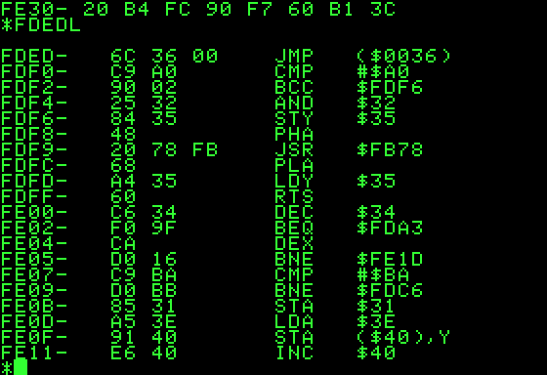



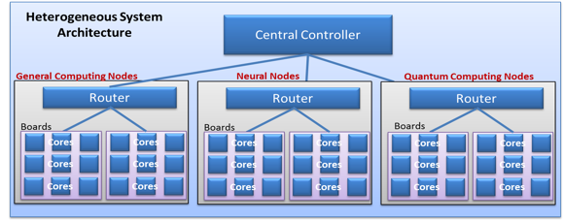





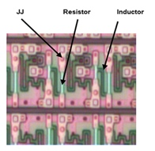







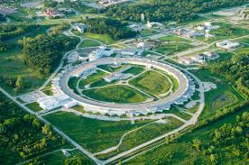









Multiscale CoDesign Framework
Programming paradigms
System architecture modeling
Component hetero-integration
Multiscale CoDesign Framework
MESAFab
Device demonstration
Device physics
Fundamental material science
APS
Notes:
So this really is a multiscale problem that would need a multi-lab effort. Looking at the problem, we start at the bottom fundamental materials science that then feeds into device physics and then up to logic device demonstration followed by large scale heterogeneous integration and then system architecture modeling and finally programming paradigms. All these capabilities currently exist throughout the lab complex.

Slide 38
How do we get to 10 fJ per inst?
CMOS scaling not providing significant energy efficiency gains
Many algorithmic, architectural, and device answers:
  Neuromorphic algorithms
  Analog accelerators
  mV switch (e.g. TFET, NgcFET)
  Superconducting electronics, quantum computing…
Which horse should we bet on??
Well…studies for each approach “prove” each respective option to be the best path forward
Winner not yet clear, most will require major development efforts to realize full potential ($$)
Need systematic, universal method to determine best approaches for further investment…
Notes:
All of these technologies have a claim somewhere that they will enable fJ computing

